Slide 1


WEEK OF LEARNING
DAY 8 MEETUP | M S Ramaiah Institute of Technology
Supported by
MSDC, RIT

Slide 2
1. Introduction to JavaScript
Notes:
What do you about JavaScript so far? What can we do by JavaScript?

Slide 3
What is JavaScript
JavaScript is one of the world’s most popular programming languages which allows you to create interactive user interface in a web page.
It’s not too much to say that every modern website uses JavaScript. It’s an essential and versatile language.
Notes:
・ Most popular
・NOT ONLY webpage - Servers, SmartPhone App, Games,

Slide 4
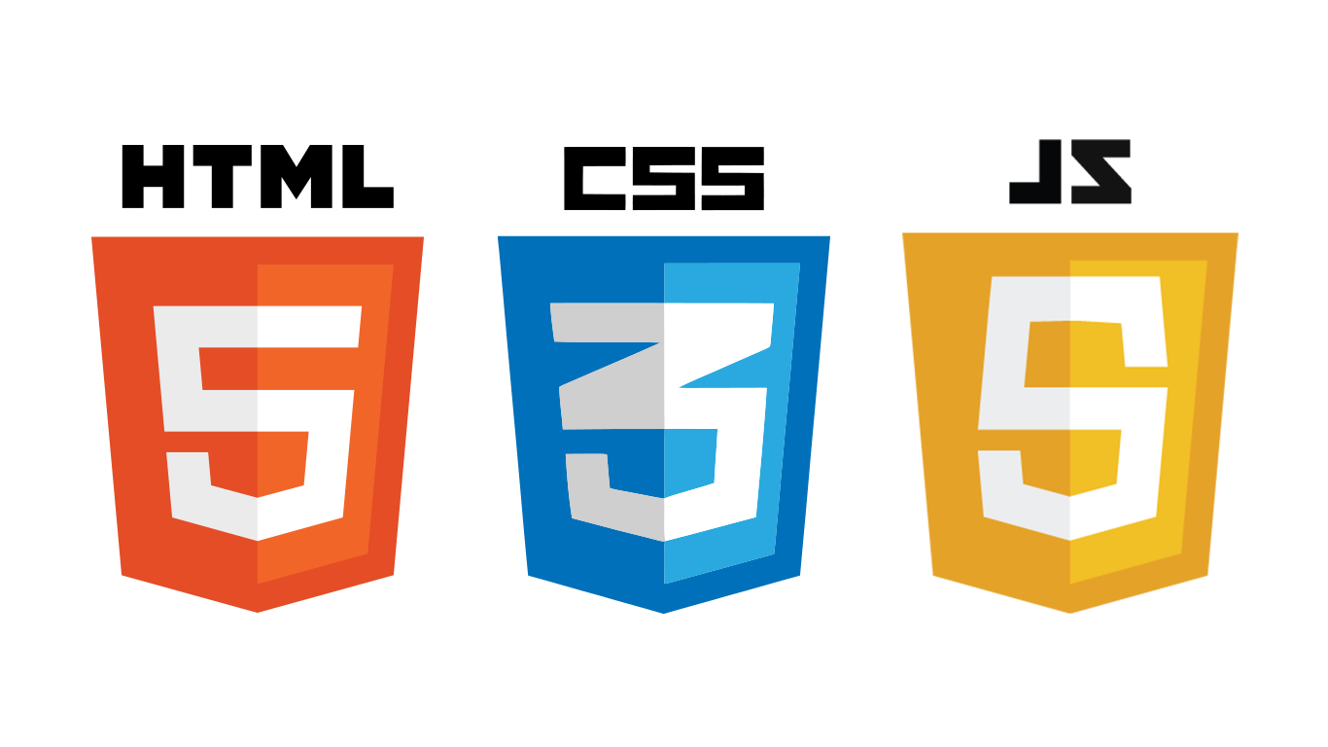
Main usage of JavaScript
JavaScript is often used with HTML and CSS.
If you have knowledge of those 3 languages, you can build a beautifully decorated and dynamic website.
e.g. https://progate.com/about

Slide 5



JavaScript Front-end Frameworks/Libraries
JavaScript has been continuously evolving and many frameworks/libraries were developed to make building a dynamic website easy.
3 top JavaScript front-end frameworks are React, Vue and Angular. Progate is built with React.
(Front-end is everything involved with what you see in the browser.)
Notes:
・Frameworks - Convenient tool for …?
・Front-end ・React: facebook Vue: Somebody who used to worked for Google Angular: Google ・Reliable and worth learning

Slide 6

JavaScript working on server side
Node.js makes it possible to use JavaScript on server side.
The idea of using JavaScript only on front side was changed. You have a choice to use JavaScript instead of Ruby, Java, and Python, which are known for server side languages.
Notes:
Opposite to FrontEnd (What you can see on browser) Server side - YOu cannot see in the browser Logic and Algorithm, manipulate Database (Loading, Updating, Analysing,Saving Data, )

Slide 7
Let’s learn JavaScript
JavaScript works both front side and server side. It is a completely versatile language and one of the best choices for beginners to start with.
You need to learn practical modern frameworks in the future, but you have to learn the basics of Javascript itself before.

Slide 8
Let’s learn JavaScript
Today we are building a calculator app with plain JavaScript.
You don’t have to use frameworks for a simple web application. Plain JavaScript can do lots of things and give you an opportunity to build a web application.

Slide 9
Participants Slide
We have a slide for participants. For all the participants, please open this slide!
If you miss some code explained by an organizer, you can see it from here:
bit.ly/progate-day8-slide

Slide 10
2. Building a Calculator App

Slide 11
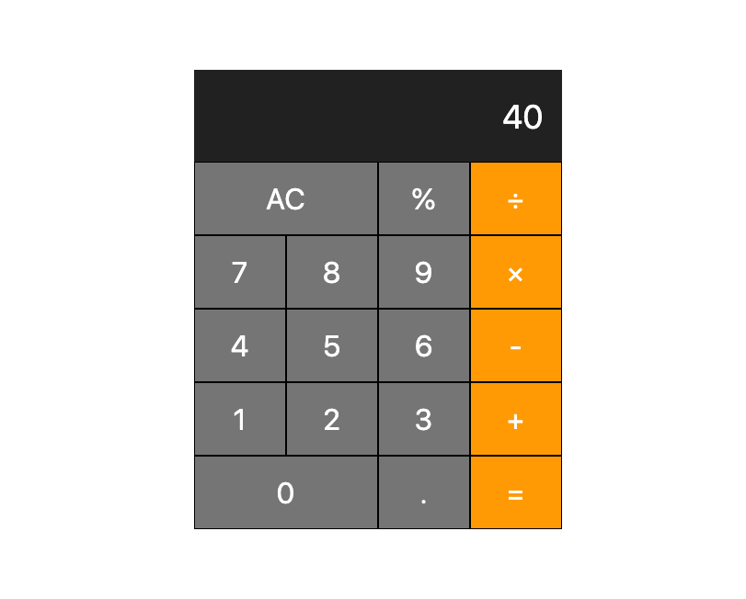
What We Will Build
We will build a calculator app like the image below.

Slide 12
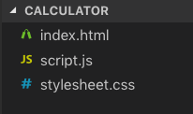
Preparation
Create a folder named “calculator”.
We need 3 files in total. A html file, css file and JavaScript file. Create the files in the calculator folder.
Open the folder with your text editor.

Slide 13
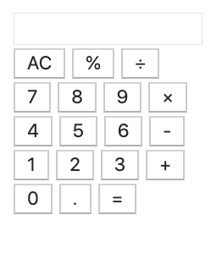
Build a Calculator App
Step 1:
Add html code to index.html

Slide 14
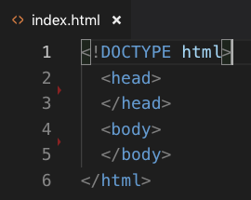
Add Basic Structure of HTML Document
Add basic structure of HTML to index.html.
The DOCTYPE declaration, <head> tag and <body> tag are needed.
rf. https://progate.com/html/study/1/10#/30

Slide 15
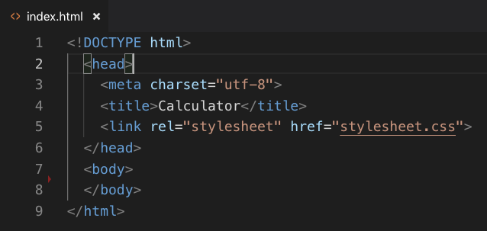
Add Contents within <head> Tag
Add contents within <head> tag. The character encoding and title and the link to CSS file are needed.
rf. https://progate.com/html/study/1/11#/33

Slide 16
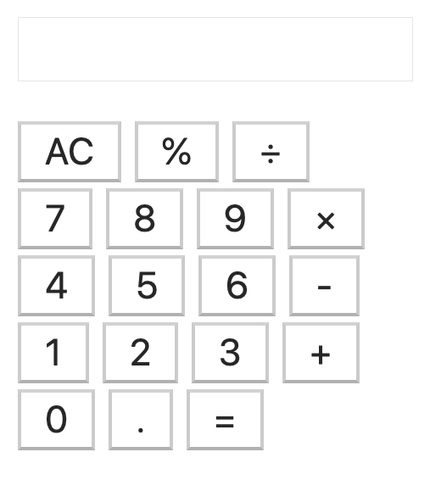
Main Layout of Calculator
calculator
calculator-screen
row
calculator-keys

Slide 17
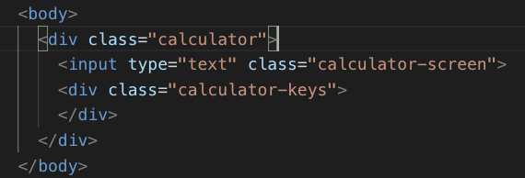
Add Tags for Main Layout
Add a <div> tag with “calculator” class.
Add an <input> tag with “calculator-screen” class and a <div> tag with “calculator-keys” within “calculator” class.

Slide 18
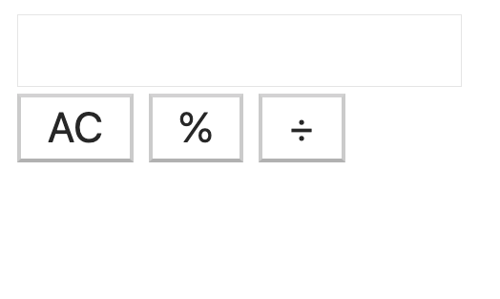
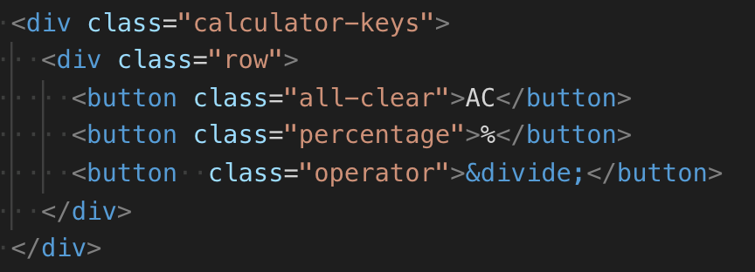
Add HTML for Calculator Keys
Add a <div> tag with “row” class and 3 <button> tags for the first row within the “row” class.

Slide 19
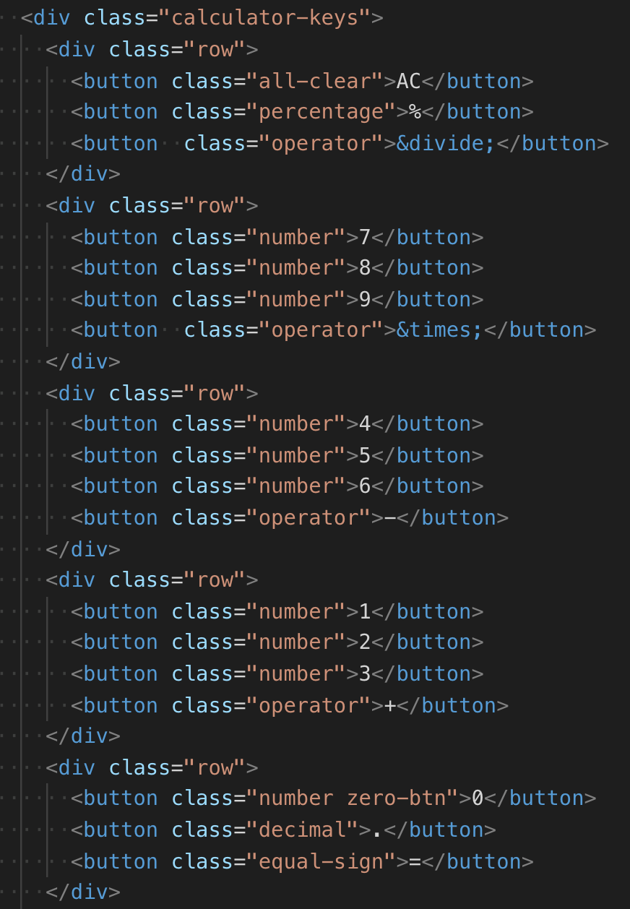
Add HTML for Other Rows
Add 4 more <div> tags with “row” class and <button> tags inside it.
Add class named “number”, “operator”, “decimal”, “equal-sign”, “all-clear”, “percentage”, and “zero-btn” to button tags.

Slide 20
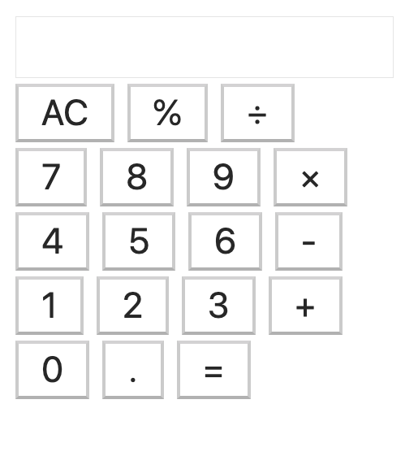
Check the Layout
It’s going well so far if your calculator app looks like the image below.

Slide 21
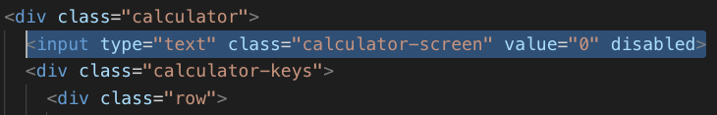
Add Value Attribute to <input> Tag
Add a value attribute and assign “0” to it. This value attribute contains the value displayed in the input form.
Add “disabled” to the input tag as well. This attribute makes it impossible to input numbers with your keyboard. This is just for keeping your code simple and easy to understand because handling key press is a little complicated.

Slide 22
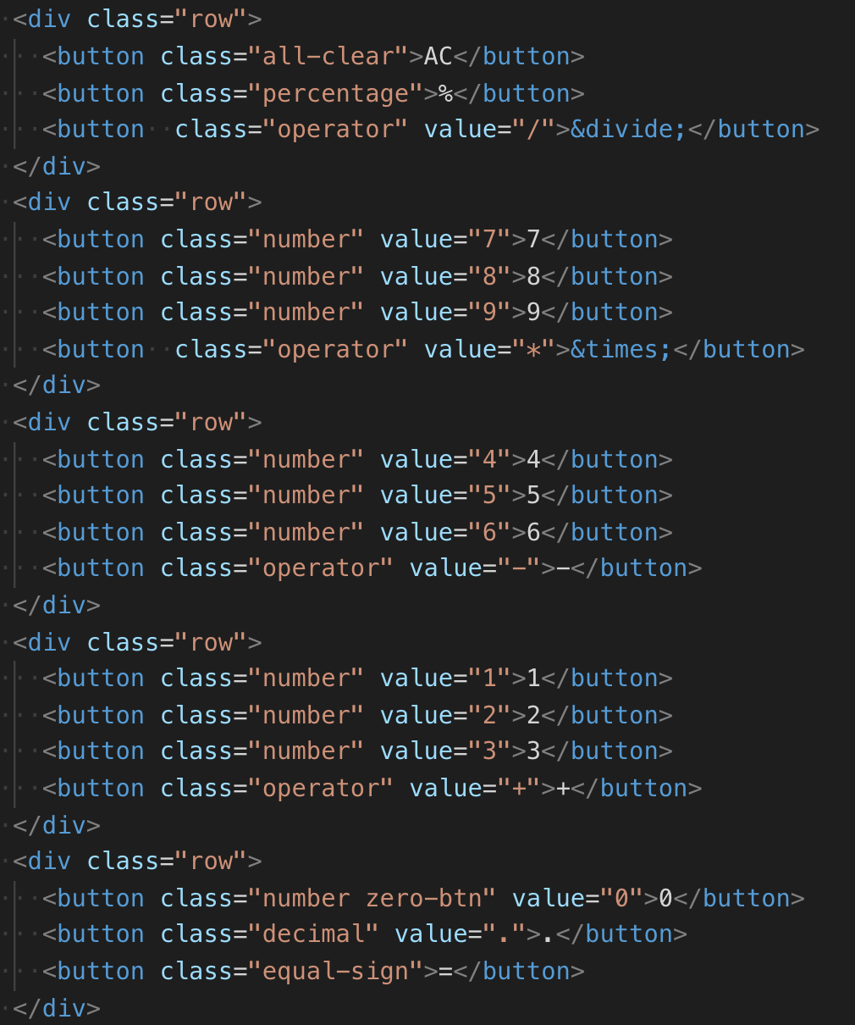
Add Value Attribute to <button> Tags
Add value attribute to button tags with “number”, “operator” and “decimal” class. It has nothing to do with the text shown on the button, but we will use them in JavaScript code later.

Slide 23
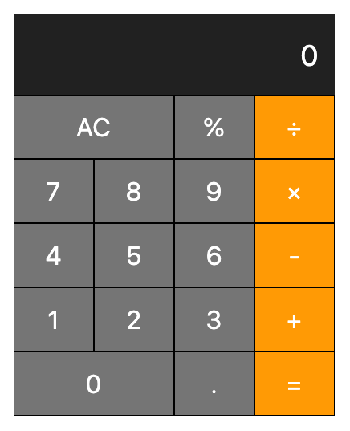
Build a Calculator App
Step 2:
Add CSS code to stylesheet.css

Slide 24
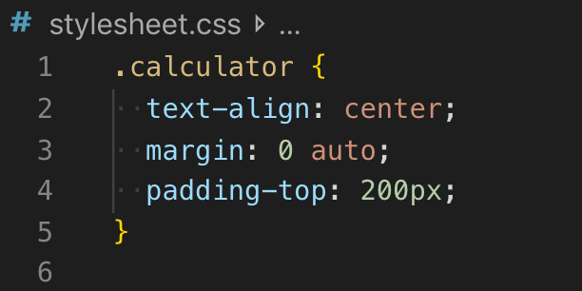
Centering the Calculator
Add CSS code to calculator class to center the calculator.

Slide 25
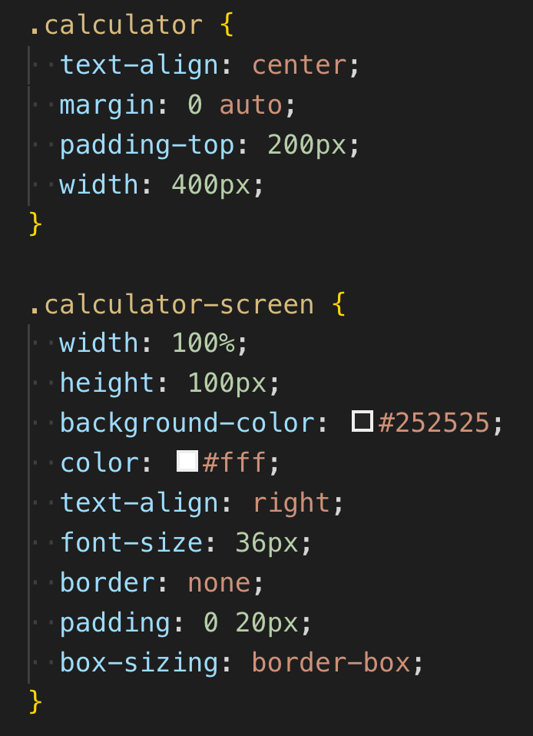
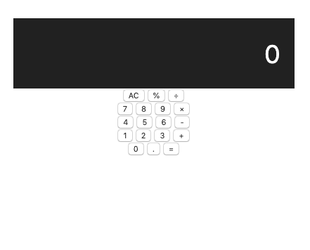
Making calculator-screen Looks Well
Add width: 400px; to “calculator” class.
Add styles to “calculator-screen” as shown in the image on the bottom right.

Slide 26
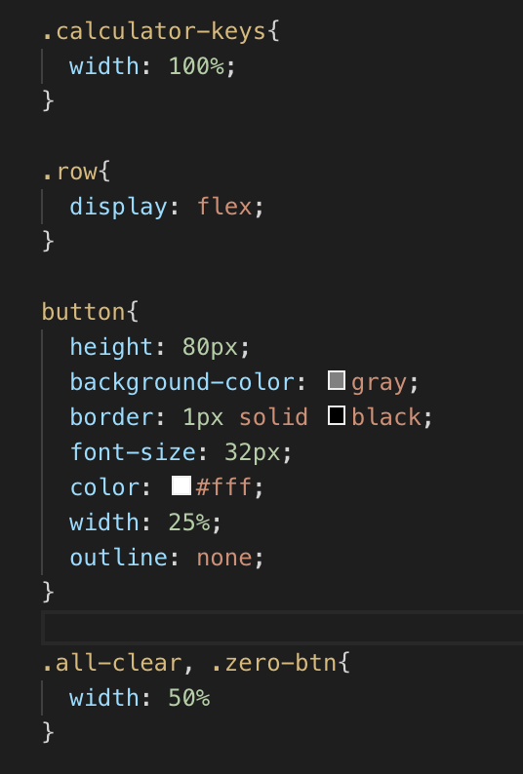
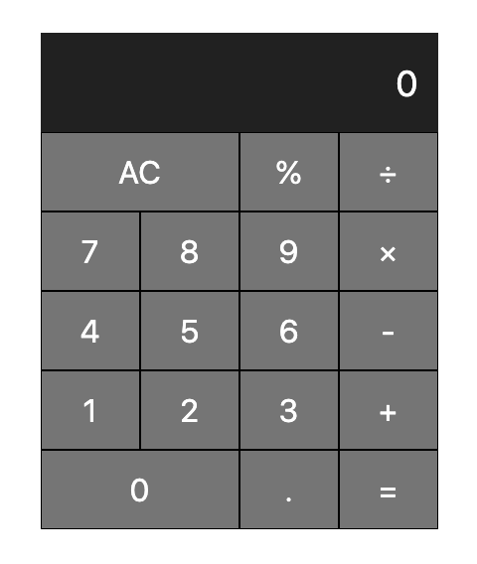
Modify calculator-keys Layout

Slide 27
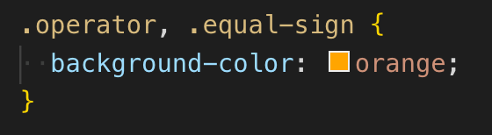
Make the Operators and Equal Sign Orange
Overwrite the background-color of buttons with “operator” class and “equal-sign class”.

Slide 28
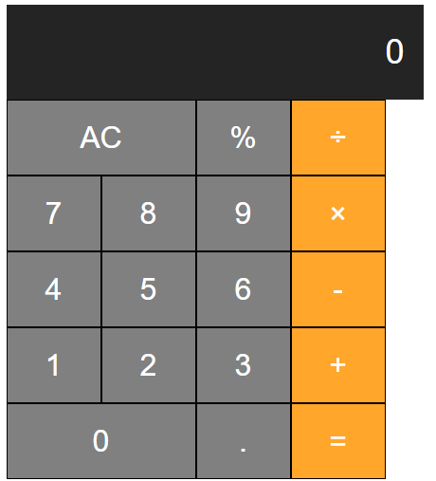
【Tips】Modify calculator-keys Layout
If the style of calculator is broken like the image below, add box-sizing: border-box; to calculator_screen class(.calculator_screen) in stylesheet.css file

Slide 29
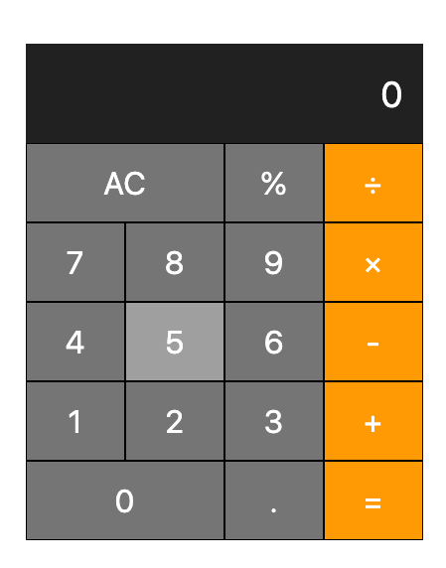
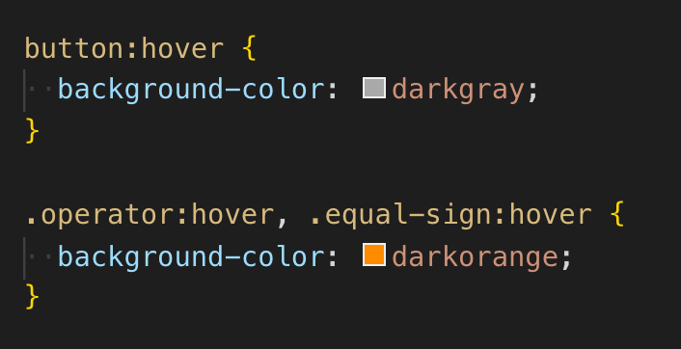
Change Background Color When Cursor is on a Button
Change the background-color of buttons when the cursor is on a button.

Slide 30
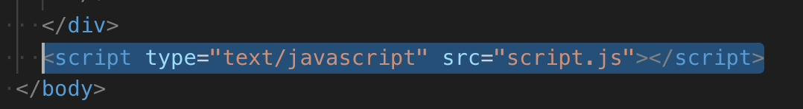
Connect HTML File with JavaScript File
You need to connect HTML file with JavaScript file before actually adding JavaScript code, which can be done with <script> tag.
You can add the <script> tag anywhere in the <body> tag of HTML file, but it’s common to place it just before the end of body tag because HTML will be loaded before the JavaScript file.

Slide 31
Build a Calculator App
Step 3:
Enable to input numbers and show them in the screen

Slide 32
How to Input and Show Numbers
Let’s enable to input and show numbers. The procedure is as follows.
When a button is clicked,
Detect the button click.
Get the number clicked.
Run a function to update the the screen.

Slide 33
Detect a Button Click
You need to set “click event” to detect a button click, which can be done with “event listener”.
(It isn’t covered on Progate JS lessons, but it’s not that difficult.)
There are 2 steps for setting click event.
Get an HTML element in JavaScript code.
Add click event to the element with “event listener”.

Slide 34
Get a HTML Element in JS Code
You can get elements with document.querySelectorAll(“.class name”) or
document.querySelector(“.class name”).
The querySelectorAll is used when you want to get multiple elements and querySelector is used when you want to get a single element.
We will use querySelectorAll this time because there are multiple buttons with the “number” class and we want to retrieve them all.

Slide 35
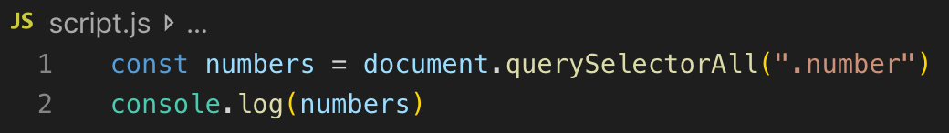
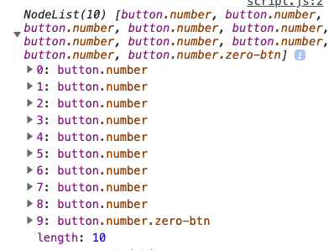
Get a HTML Element in JS Code
Let’s get the <button> elements with the “number” class and print them in the console.

Slide 36
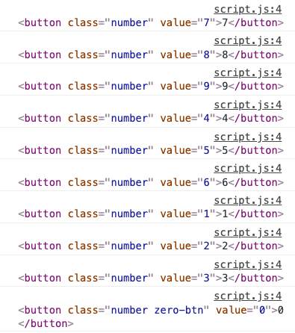
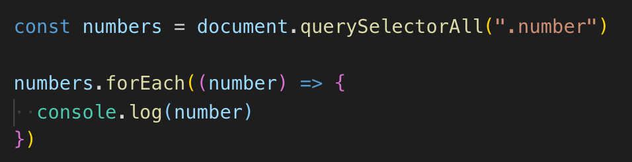
Get each number from “numbers” constant
The event listener should be added to each element, so we need to get them one by one. You can use the forEach method for this.
rf. https://progate.com/es6/study/6/2#/7

Slide 37
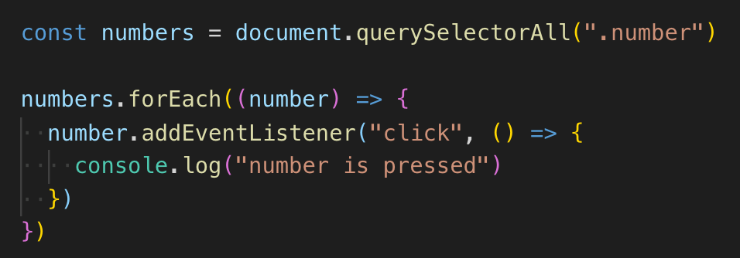
Add Click Event to Each Element
Let’s add a click event to each element with addEventListener.
It’s going well if the text “number is pressed” is displayed in the console when a button is clicked.

Slide 38
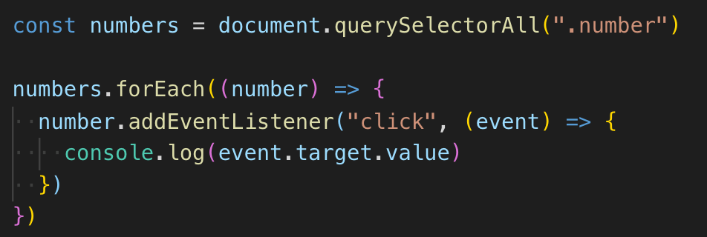
Get the number when it’s pressed
Now that click events are set to <button> elements, it’s time to get the numbers from them.
You need to add an event argument and then you can access the number with event.target.value. This value comes from the value attribute you added to the <button> tags before.

Slide 39
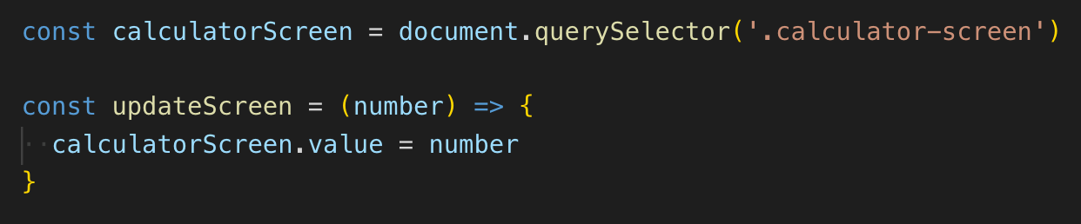
Define a Function to Update Screen
What you need to do next is enable the screen to be updated when a button is clicked.
You can update the number displayed in the screen by updating the value attribute of the <input> tag. Let’s get the element in JS code and define an “updateScreen” function to update the value.

Slide 40
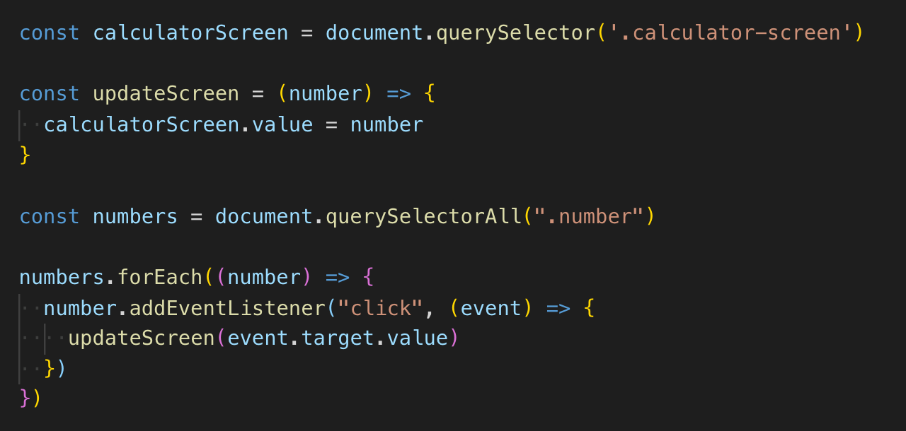
Update screen when a number button is pressed
Run the “updateScreen” function with event.target.value as the argument when a button is clicked.

Slide 41
Recap of This Step
It might seem complicated but what you have done is just get HTML elements and manipulate them in JS code.
Get the <button> element with the “number” class.
Add click event to each element and run “updateScreen” function when a button is clicked.
Update the value attribute of <input> element within the “calculator-screen” using the “updateScreen” function.

Slide 42
Break Time

Slide 43
Build a Calculator App
Step 4:
Store numbers and an operator for calculation

Slide 44
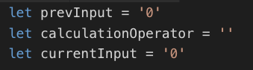
Define Variables for Calculation
What you need for a calculation is 2 numbers and an operator.
Define 3 variables named “prevInput”, “currentInput” and “calculationOperator” to store 2 numbers and an operator. The “currentInput” should have 0 as the initial value.

Slide 45
How the Variables Works
prevInput currentInput operator displayed
Press 3 3 3
Press + 3 + 3
Press 5 3 5 + 5
Press = 8 8

Slide 46
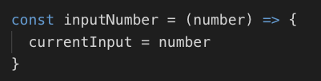
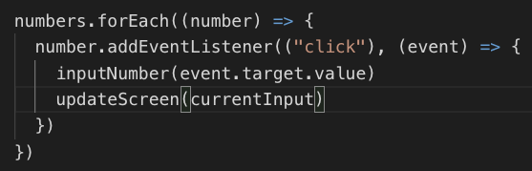
Assign the Number Pressed to the currentInput Variable
Let’s define an “inputNumber” function and run it when a number is pressed.
In the “inputNumber” function, assign the number pressed to currentInput. Also change the argument of “updateScreen” to currentInput.

Slide 47
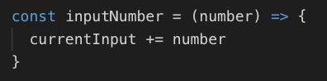
Enable to Input More than 2 Digit Numbers
Now you can input a number and update the screen but cannot input more than 2 digit numbers at the moment.
This can be solved using string concatenation, because a number stored in the “currentInput” variable is a string.

Slide 48
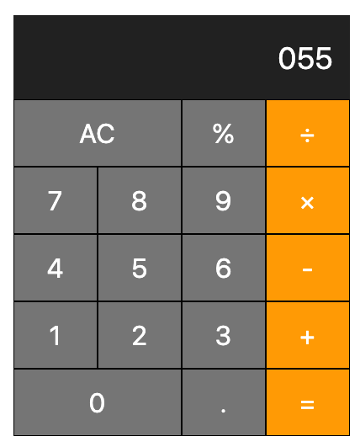
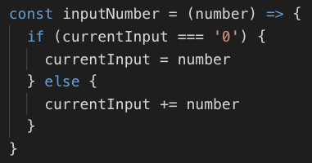
A problem when 0 is pressed first
There is a problem that the number displayed can start with 0. Let’s fix this using an if statement.

Slide 49
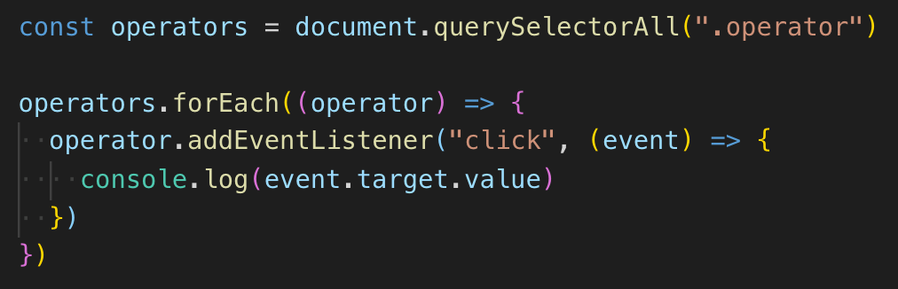
Add Click event to operator buttons
Let’s move on to the operator part. First thing you should do is the same as the number part. Get <button> elements with “operator” class and add click event to each operator button.
Don’t forget to check that the code is working in the console.

Slide 50
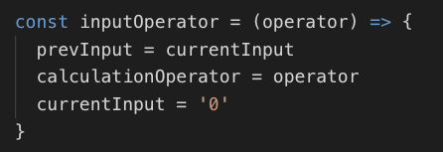
Define inputOperator function
Let’s define an “inputOperator” function. What we want to do in the function is ...
Assign the value stored in currentInput to prevInput.
Assign the operator, passed as an argument, to calculationOperator.
Assign 0 to the currentInput.

Slide 51
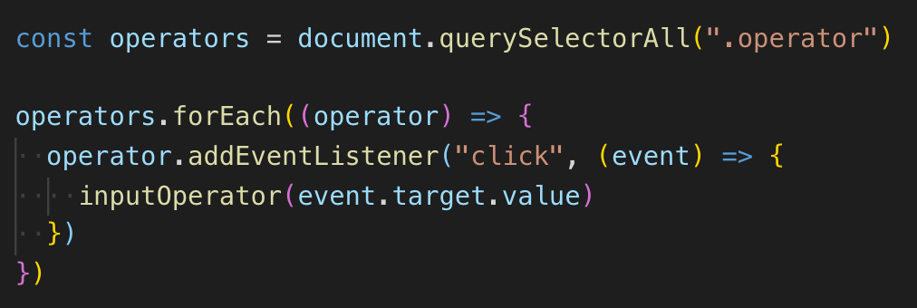
Run inputOperator Function When an Operator is Clicked
Run the “inputOperator” function when an operator is clicked.
We don’t call updateScreen this time because we want to keep showing the previous number.

Slide 52
Build a Calculator App
Step 5:
Enable to calculate numbers

Slide 53
What to do in this step
Now that we have 2 numbers and an operator stored in the 3 variables, let’s make it possible to calculate the numbers in this step.
What we should do is define a “calculate” function and run it when the equal button is pressed.

Slide 54
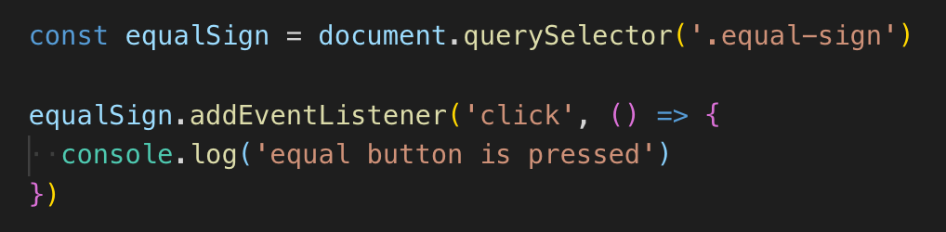
Add click event to equal button
Get an element and add a click event to it. This time there is only one button with ”equal-sign”, so we will use querySelector instead of querySelectorAll.

Slide 55
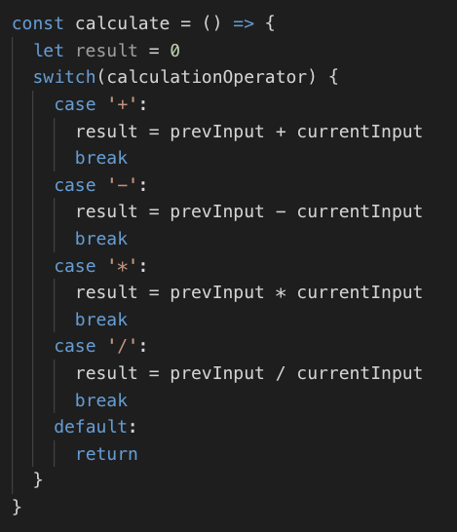
Define calculate Function
Let’s define a calculate function. There are 4 patterns of calculation, which are addition, subtraction, multiplication and division. Add 4 cases depending on the value stored in calculationOperator variable.

Slide 56
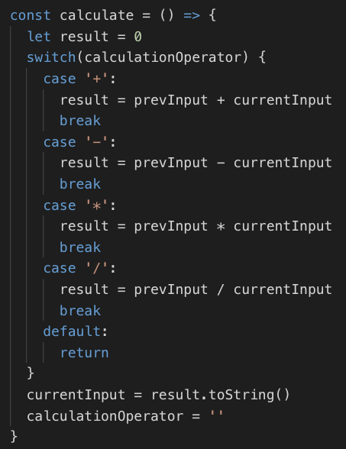
Store the Calculation Result to currentInput
The result of the calculation should be shown in the screen. Let’s update the currentInput variable with the result.
Also the value contained in calculationOperator should be empty.

Slide 57
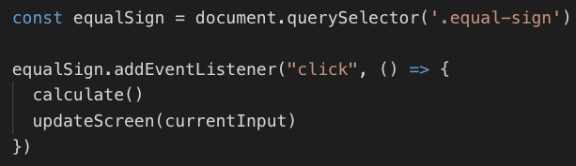
Run calculate Function When Equal Button is Pressed
Run the calculate function when the equal button is clicked. And update the screen after calculation.

Slide 58
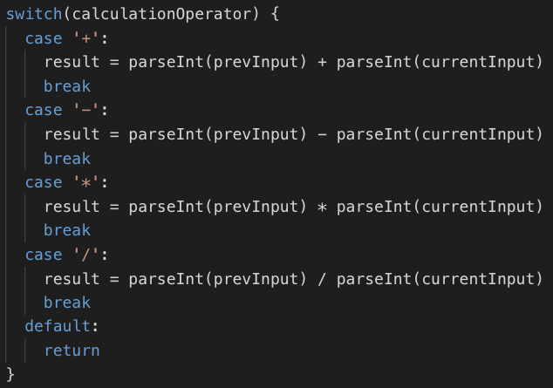
Solve a Problem on Addition
Since the numbers are stored as strings, the addition doesn’t work. To avoid string concatenation this time, you need to change the numbers to integers. It can be done with parseInt method.

Slide 59


Slide 60



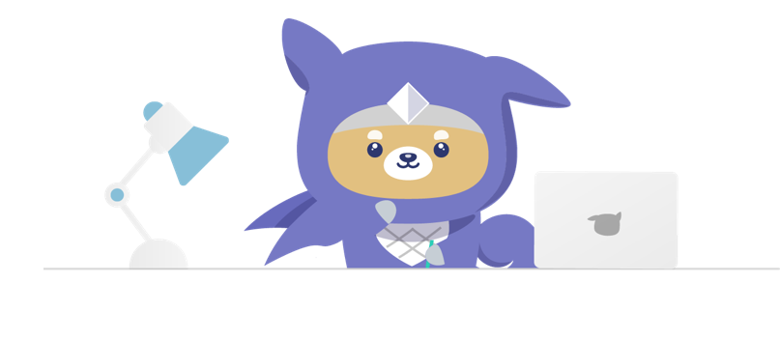
Next Steps to Learn More
Now you understand the basic concept of JavaScript and how to build a simple application in your local environment combining HTML, CSS and plain JavaScript.

Slide 61

WEEK OF LEARNING
Webathon

Slide 62
About Webathon
Rules for participants
All students who’ve attended the Week of Learning Day 8 Meetup are eligible to join online project making competition, “Webathon”.
You will submit the project individually.
Once you make a project, submit it latest by 11:59 PM here by (Date): bit.ly/weekoflearningprogatesubmission

Slide 63
About Webathon
Make your own project
We prepared a project which you will be working on. Please download the project below.
Complete the project by developing your original functions with HTML, CSS and JavaScript.
bit.ly/webathon-sample-project

Slide 64


About Webathon
Webathon THEME
“Anything which helps the aspiring developers and beginners who’re learning to code”
Hello World!

Slide 65
About Webathon
Judging Criteria
Implementation of HTML, CSS and JavaScript concepts:
10 Points
Creativity:
5 Points
Usefulness:
5 Points

Slide 66
About Webathon
Development Tips
Here’s what you might need to know for the project
Page Navigation (HTML)
Connecting HTML & JavaScript (HTML & JS)
EventListener (JS)
Don’t hesitate asking us if you don’t know what/how to develop the functions!

Slide 67

Thank you!!

